Slide 1

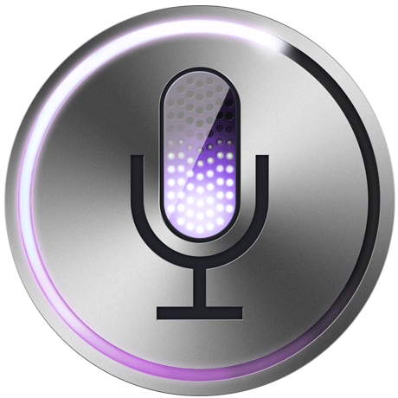



Mobile Gaming on Personal Computers with Direct Android Emulation
Qifan Yang , Zhenhua Li, Yunhao Liu, Hai Long,
Yuanchao Huang, Jiaming He, Tianyin Xu, Ennan Zhai
Slides prepared in part by Xinlei Yang
Notes:
Thanks for the introduction.
in this talk I would like to share with you our idea of direct Android emulation on personal computers,
in particular, why we need this idea for mobile gaming, and how we realize it in large-scale practice.
This is a joint work of Tsinghua University, Tencent company, and so forth.
Three of the authors are here: me, Zhenhua Li and Xinlei Yang.

Slide 2
Outline
1. Background
2. State-of-the-Art
3. Our Idea and Design
4. System Implementation
5. Summary
Notes:
This is the outline of our presentation. (按一下)
First, let ’s look at the background.

Slide 3
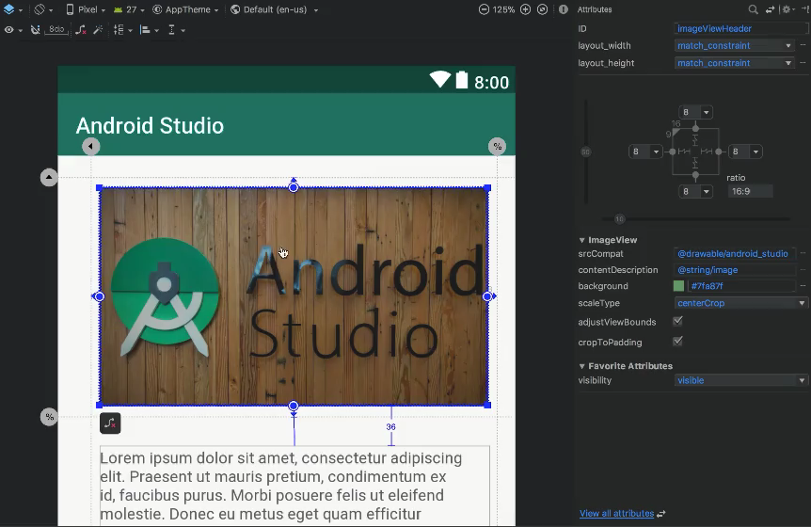
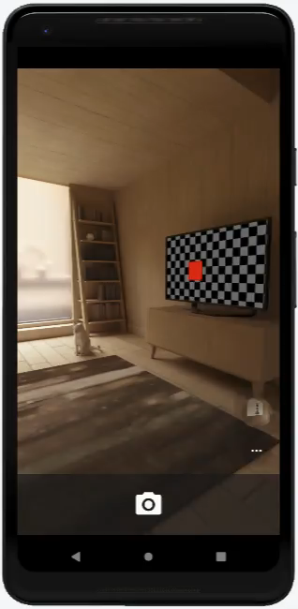

1. Android Emulators
Development and Debugging of Android Apps on PCs
Much more convenience and functions
Notes:
Android emulators are crucial to the development and debugging of Android apps, because they can emulate mobile devices of any size, any system version, and [click video] various sensors.
Therefore, they bring much more convenience and functions to Android researchers and developers.

Slide 4
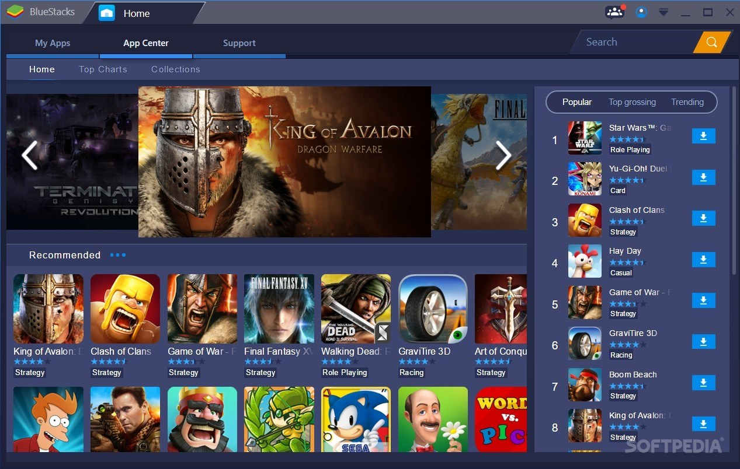

1. Android Emulators
Cross-platform Android app execution, especially games
70+ commercial competitors, over 1 billion users
……
Notes:
In fact, even for non-professional users, Andriod emulators are also very useful, because they enable cross-platform Android app execution, especially for mobile games.
Nowadays, there are more than 70 commercial competitors in this market, attracting over 1 billion users.

Slide 5
2. State-of-the-Art: AOVB
Android Apps
Android Apps on Android-x86
Android-x86 OS On VirtualBox
(both open-source)
VirtualBox on x86 Windows PC
Android-x86
VirtualBox
x86 Windows PC
Notes:
How can we run Android apps on a Windows PC?
The state-of-the-art solution is the so-called AOVB architecture.
Its idea is quite intuitive.
First, we run VirtualBox on a x86(X eighty six) Windows PC,
then we run the Android-x86 operating system on VirtualBox,
finally, we can run Android apps on top of a Windows PC.
AOVB is widely-used by the industry due to
its open-source nature and high compatibility.

Slide 6
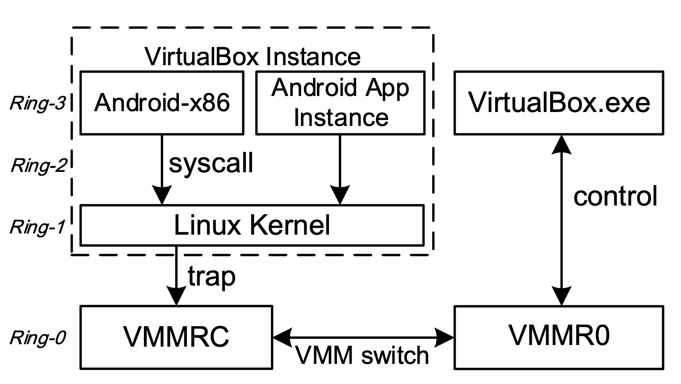
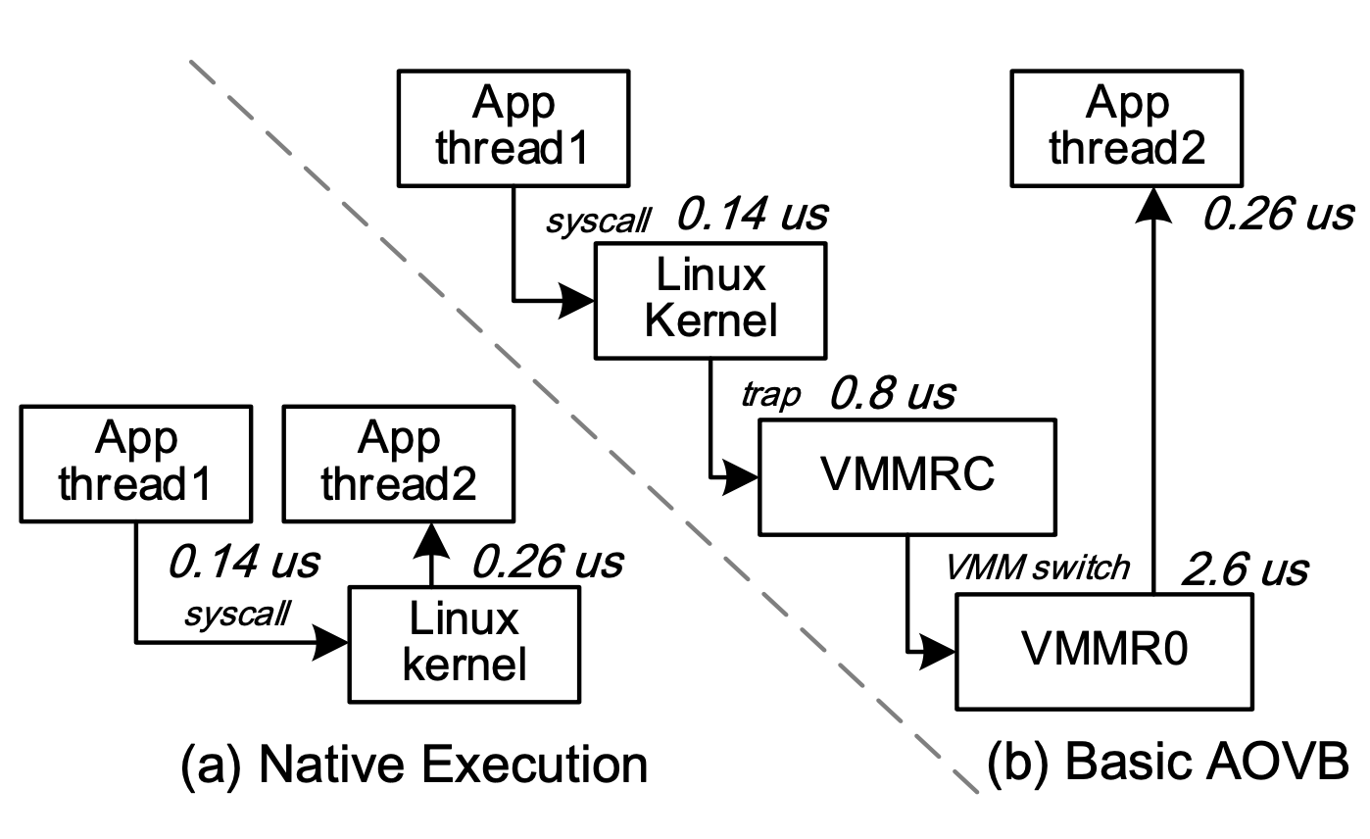
2. Bottleneck of AOVB
Full virtualization severely degrades performance
10X performance degradation in a typical case
AOVB architecture
Context switching
between two threads
Notes:
However, we find that full virtualization severely impacts the overall performance,
because the Linux kernel always traps into VirtualBox when running privileged instructions.
For example, nearly 10 times performance degradation occurs in the case of context switching between two threads of the same app.

Slide 7
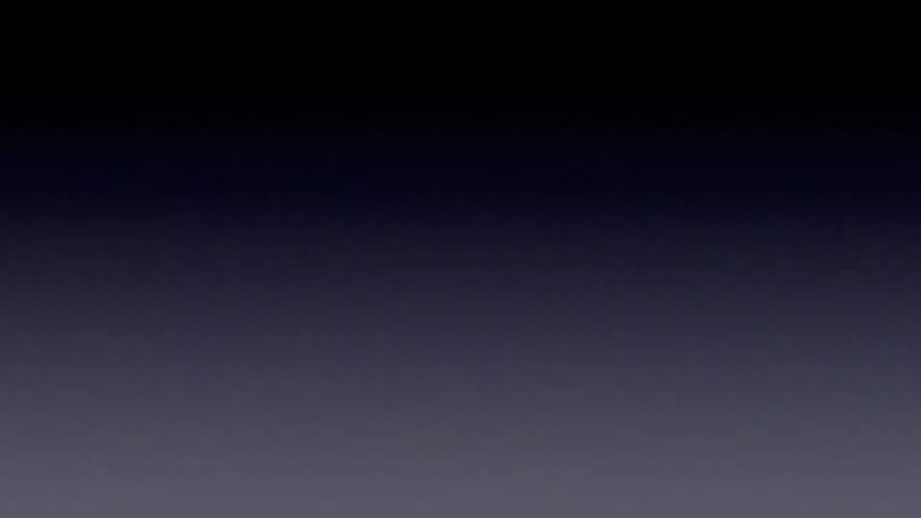
2. Poor Smoothness of AOVB
Poor smoothness impacts not only the user’s experience but also win/lose!
Notes:
How well does AOVB actually perform when running 3D computation-heavy Android games?
From the video clip, we can see the poor FPS and smoothness of AOVB
on a conventional PC.
Worse still, poor smoothness impacts not only the user’s experience but also the outcome of the game.

Slide 8
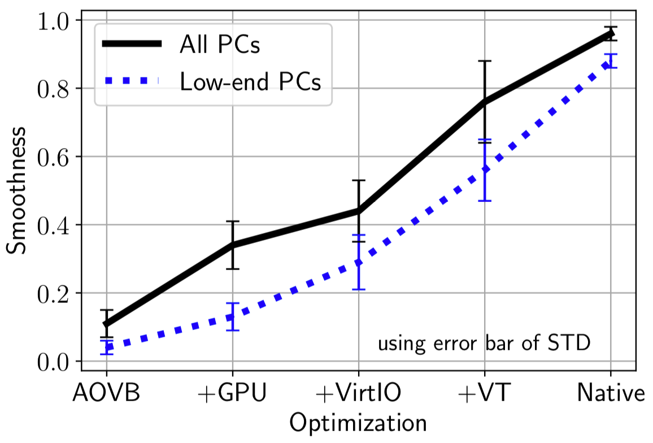
2. Optimizations to AOVB
VirtIO: virtual I/O interface increases throughput of the rendering data pipeline
between Android App Instance and Media Host
VT: hardware-based acceleration for virtualization by Intel
Native: natively runs an Android App on a smartphone
Notes:
In fact, several optimizations can be made to improve the performance of AOVB, including GPU acceleration, VirtIO, virtual I/O interface increases throughput of the rendering data pipeline
between Android App Instance and Media Host ,
and VT, the hardware virtualization acceleration by Intel
Even so, when we natively run an Android app on a smartphone,
We can see there is still a performance gap between AOVB and Native.

Slide 9


x86 PC
Hardware
图
3. Key Idea: Direct Android Emulation
Directly execute Android app binaries on top of x86 Windows
Offer foreign Android binaries direct access to the domestic PC
hardware through Windows kernel interfaces
Achieve nearly native hardware performance
Windows
Kernel
(without modification)
Challenge 1: Different data structures and execution behaviors of binaries between ARM-based Android and x86 Windows
Challenge 2: Distinct sets of system calls (syscalls)
Challenge 3: Interaction gap between mobile and PC-based gaming
Notes:
To address the performance issue of AOVB,
We pose a challenging question here: is it possible to directly execute Android app binaries on top of x86 Windows? If possible, we can provide foreign Android binaries with direct access to the local PC hardware, so that we can achieve nearly native hardware performance.
[按一下]
Nevertheless, our target is confronted with three challenges when we run an ARM-based Android app on a x86 Windows PC:
First, their data structures and execution behaviors of binaries are different.
Second, Linux and Windows have different system calls.
Third, there exists an interaction gap between mobile and PC gaming.

Slide 10
3.1 ISA: Binary Rewriting
ARM ISA → x86 ISA (Instruction Set Architecture)
  Android-x86: Android OS in x86
  Intel Houdini: dynamic binary translation for apps
Linux x86 binary → Windows x86 binary
800+ x86 instructions
240+ instructions need rewriting
10 rewrite patterns
  Large-scale static analysis
  of 500,000 Android games
  Rewriting Binaries on Loading
  + Trampoline + helper function
Notes:
Let’s look at the first challenge:
how to transform Android ARM binaries to x86 Windows binaries, with little modification.
Although Android-x86 has already ported Android OS to x86, and Intel Houdini can dynamically translate Android app binaries to x86 binaries, we still have to rewrite Linux x86 binary into Windows binary.
We know the x86 instruction set contains more than 800 instructions, which seem to be so many.
Fortunately, based on large-scale static analysis of 500 thousand Android games, we find that only around 240 cases need rewriting. However, 240 is still too large.
As a result, we further reduce the 240 cases into just 10 rewrite patterns, given that multiple instructions can be rewritten in a similar manner by rewriting binaries on loading through trampoline and helper function

Slide 11
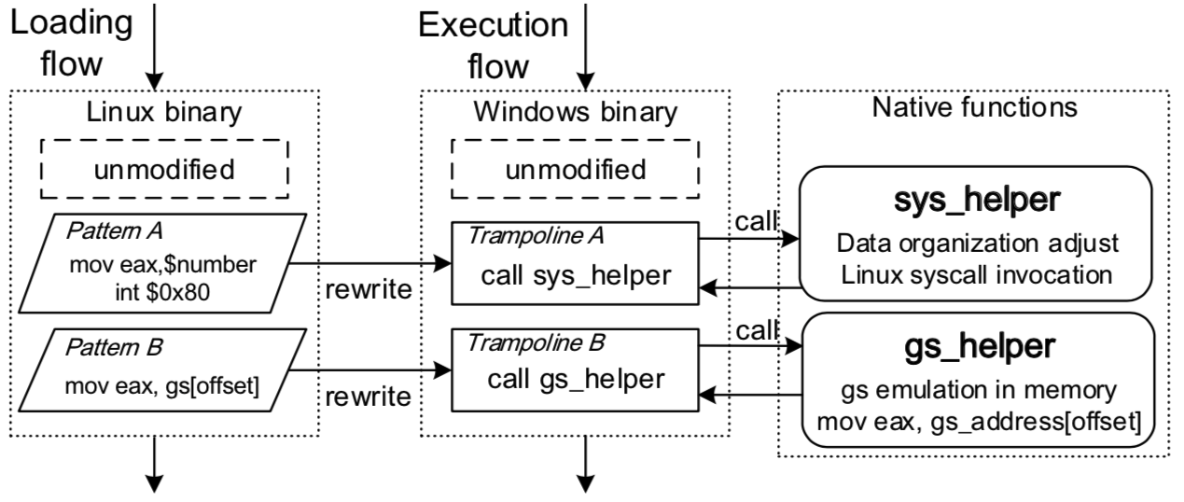
3.1 Two Patterns of Binary Rewriting
Pattern A: Linux syscall interrupt incompatible with Windows
Pattern B: Linux register gs inaccessible to 64-bit Windows
Notes:
In detail, let's explain two common patterns.
Pattern A indicates that the Linux system call interrupt is not compatible with Windows.
To handle this, when the instructions of pattern A are loaded into memory, they are first rewritten into a trampoline A,
The trampoline only cost 5 bytes so that the overall binary structure remains unchanged.
[按一下]
Then, the trampoline A calls a helper function, which is responsible for adjusting data organization into Windows standard and invoking the Linux syscall.
Next, pattern B indicates that the CPU register GS is accessible in Linux, but not in 64-bit Windows. To deal with this, we emulate GS in the memory and modify the instruction of pattern B.

Slide 12
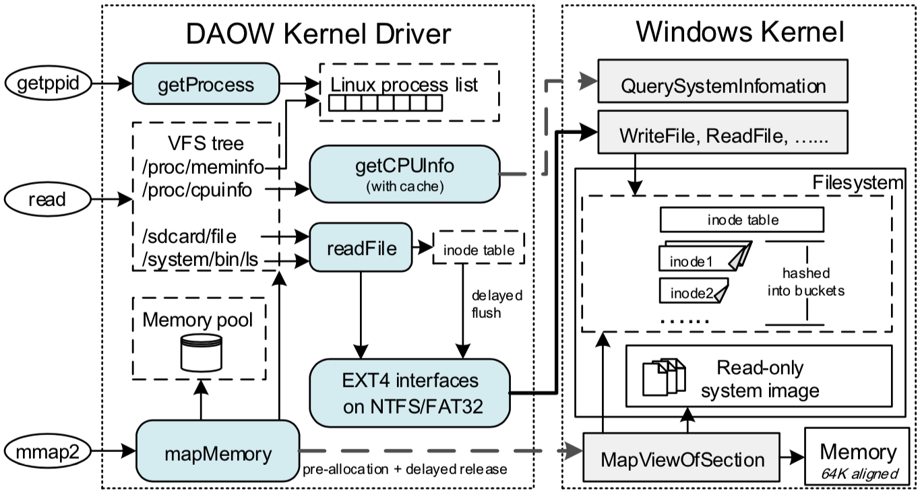
3.2 Linux Syscall Emulation
Linux syscalls → Windows syscalls
370+
Linux syscalls
200+ syscalls re-implementation
Dozens of “common divisor” syscalls & data structures
Notes:
To address the second challenge, we need to efficiently emulate Linux syscalls on Windows.
Based on dynamic analysis of numerous Android games,
We find that only around 200 out of 370 Linux syscalls need to be reimplemented.
However 200 is still too large.
As a result, we further reduce the Linux syscall emulation into just dozens of common divisor syscalls and data structures.
This helps us reduce the emulation overhead, and improve the emulation performance.

Slide 13
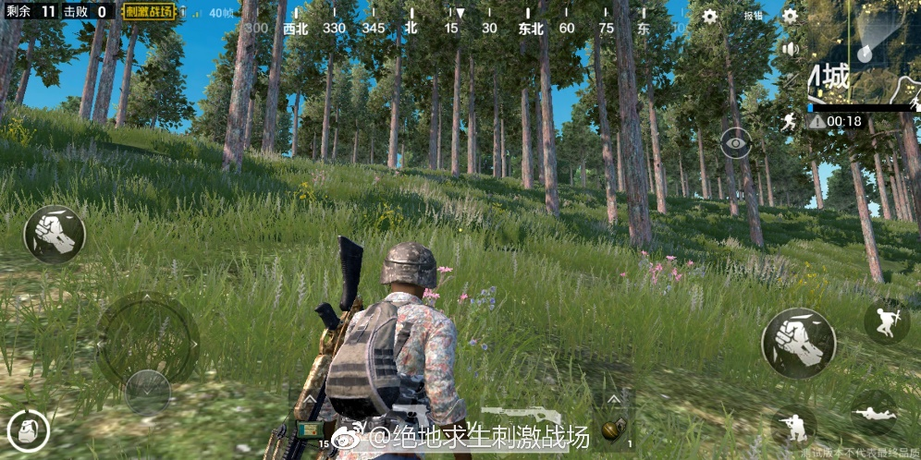
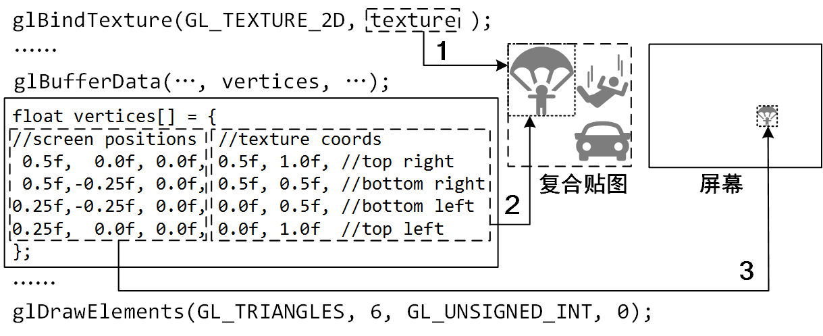
3.3 Interaction Gap: Context-aware Key Mapping
DNN models ☹
OpenGL ☺
Texture
Screen
Notes:
The third challenge is about the interaction gap between mobile and PC gaming, in particular, the context-aware key mapping.
We tap virtual on-screen buttons to play mobile games, but use physical keyboard and mouse to play PC games.
[按一下]
To achieve the mapping, the straightforward solution is to use DNN models for real-time button recognition.
However, this is not only computation intensive but also inaccurate.
Fortunately, we find a better solution by analyzing an app's OpenGL instructions, which is light-weight and accurate.

Slide 14
4.1 System Architecture
DAOW: Direct Android emulation On Windows - 500K lines of C++
Notes:
We integrate all the above efforts into a real-world Android emulator called DAOW,
that is Direct Android emulation On Windows.
It has four components:
First, the DAOW emulator initializes the Android framework and rewrites its binaries while loading them into memory.
Then, the emulator forks a Windows process for running an Android app instance.
Meanwhile, the Kernel Driver handles Linux syscalls via a series of DAOW syscalls and Windows syscalls.
In addition, Media Host deals with user input, sound, and graphics issues, as well as measures the smoothness of the game.
Finally, we use shared memory for fast media data transfer between an app instance and the media host.

Slide 15
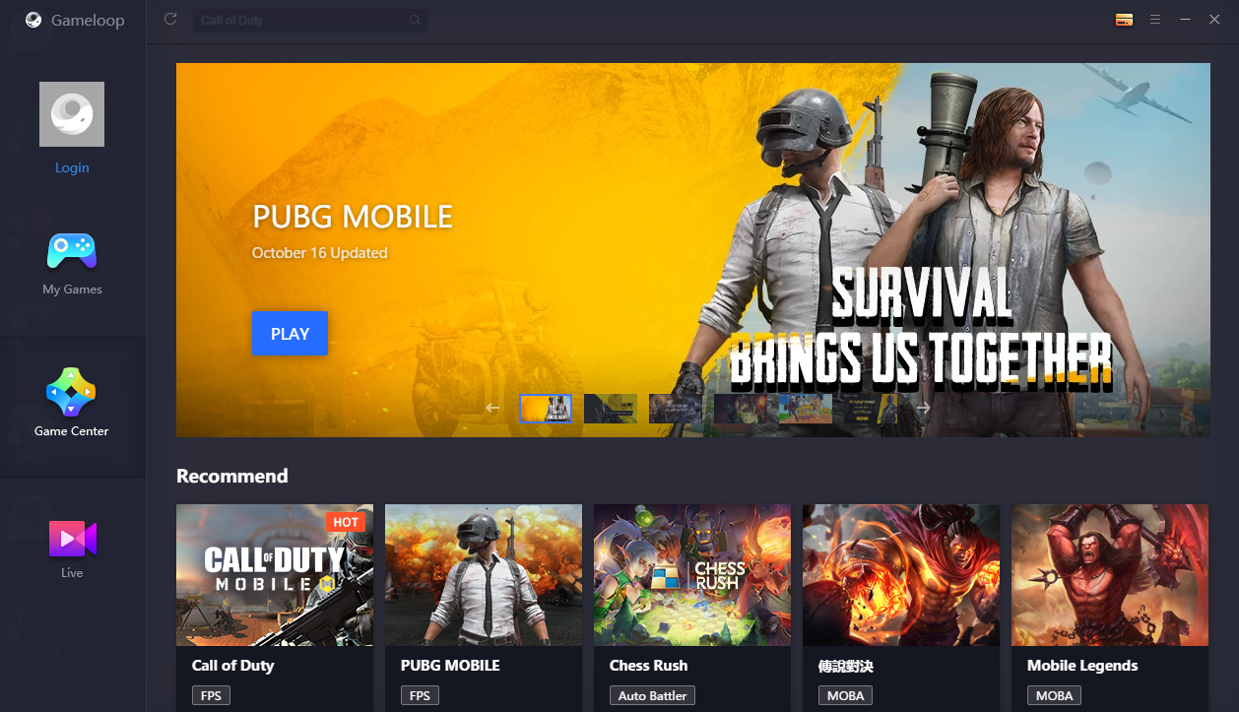
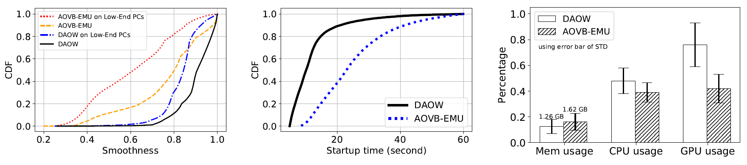
4.2 System Deployment
Launched at the end of 2017
~10M active users per month
Tencent Mobile Game Emulator
URL in English: https://gameloop.fun/
URL in Chinese: https://syzs.qq.com
Smoothness increase 21%: 0.76 → 0.92
Startup time decrease 48%: 25 → 13 sec
Memory usage decrease 22%
Notes:
Since its launch at the end of 2017， now, DAOW has more than 10 million active users per month.
Compared with AOVB,
DAOW increases the overall smoothness of Android games on an average PC from 0.76 to 0.92, that is from unsatisfactory to pretty smooth.
It also saves the startup time and memory usage.

Slide 16
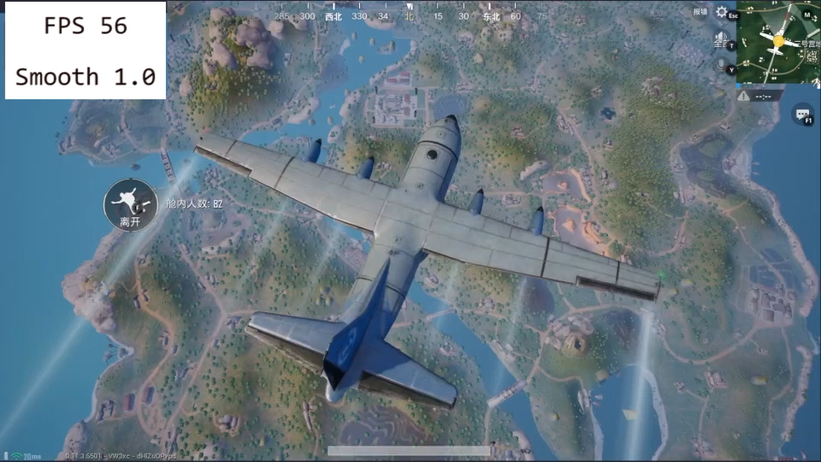
4.3 Fine Smoothness of DAOW
Notes:
Again, let’s watch a video clip of the same game running with DAOW.
We can see that the FPS and smoothness are both much higher than those of AOVB.
Also, from the user's perspective, the smoothness is close to perfect.

Slide 17
5. Summary
Efficiently emulating “heavy” mobile apps on Windows PCs has long been desired but highly challenging
We propose the novel idea of DAOW (Direct Android emulation On Windows) instead of the state-of-the-art AOVB (Android-x86 On VirtualBox)
Considerate design tradeoffs among efficiency, overhead and compatibility, as well as solid implementation and large-scale deployment/evaluation
Our work proves the practical feasibility of efficient cross-OS program execution even for an enormous number of heavy mobile applications
Notes:
In summary,
emulating “heavy” mobile apps on Windows PCs has long been desired but highly challenging
We propose the novel idea of DAOW (Direct Android emulation On Windows) instead of the state-of-the-art AOVB (Android-x86 On VirtualBox) .
This is enabled by considerate design tradeoffs among efficiency, overhead and compatibility, as well as solid implementation and large-scale deployment/evaluation.
Our work proves the feasibility of cross-OS program execution even for an large number of heavy mobile apps

